Slide 1


AWS Cloud Services
Technical sharing
DucPV - TechMey

Slide 2
Agenda
Introduction Cloud Computing
Introduction Amazon Cloud
Introduction AWS Compute

Slide 3
Introduction Cloud Computing

Slide 4

What is a server look like ?
Server room
Hardware (RAM, CPU…)
Network
Electric
Cooling system
…
Notes:
Một hệ thống server cần những gì ?
Phòng đặt server
Mua các thiết bị phần cứng
Setup mạng
Điện
Hệ thống làm mát …
=> Chi phí tốn kém

Slide 5
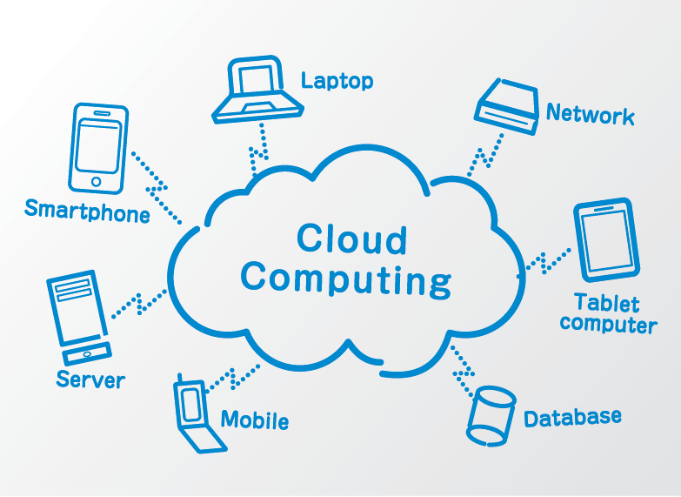
What is Cloud Computing ?
Cloud computing is the delivery of computing resources as a service, meaning that the resources are owned and managed by the cloud provider rather than the end user.
Benefit of Cloud Computing
Cost savings
Convenient
Safe and Continuous
Easy to implement

Slide 6
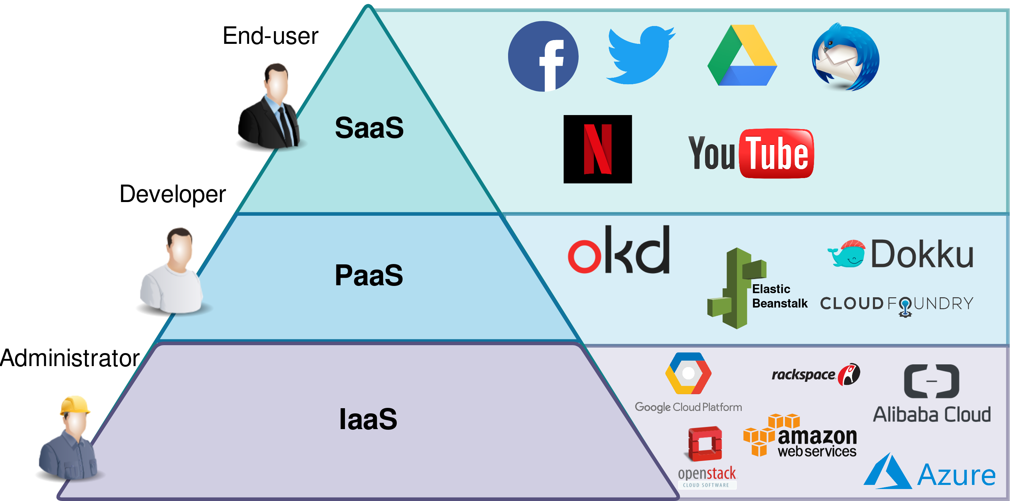
Cloud Delivery Models
Infrastructure as a Service (IaaS)
Platform as a Service (PaaS)
Software as a Service (SaaS)

Slide 7
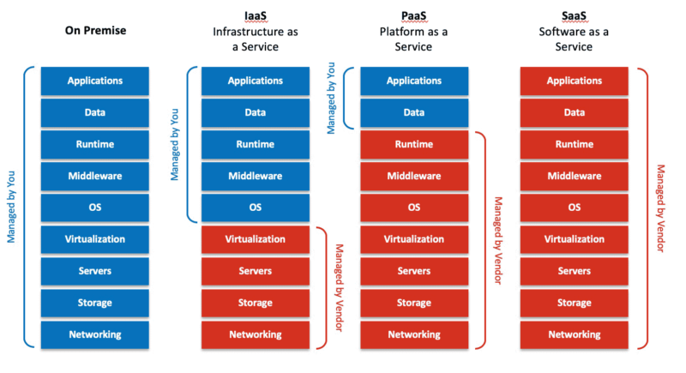

Slide 8
Introduction AWS

Slide 9
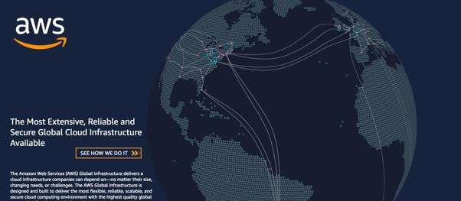
What is AWS?
AWS provides a highly reliable, scalable, low-cost infrastructure platform in the cloud that powers millions of businesses in over 190 countries around the world.
Benefits
Low Cost
Elasticity & Agility
Open & Flexible
Secure
Global Reach

Slide 10
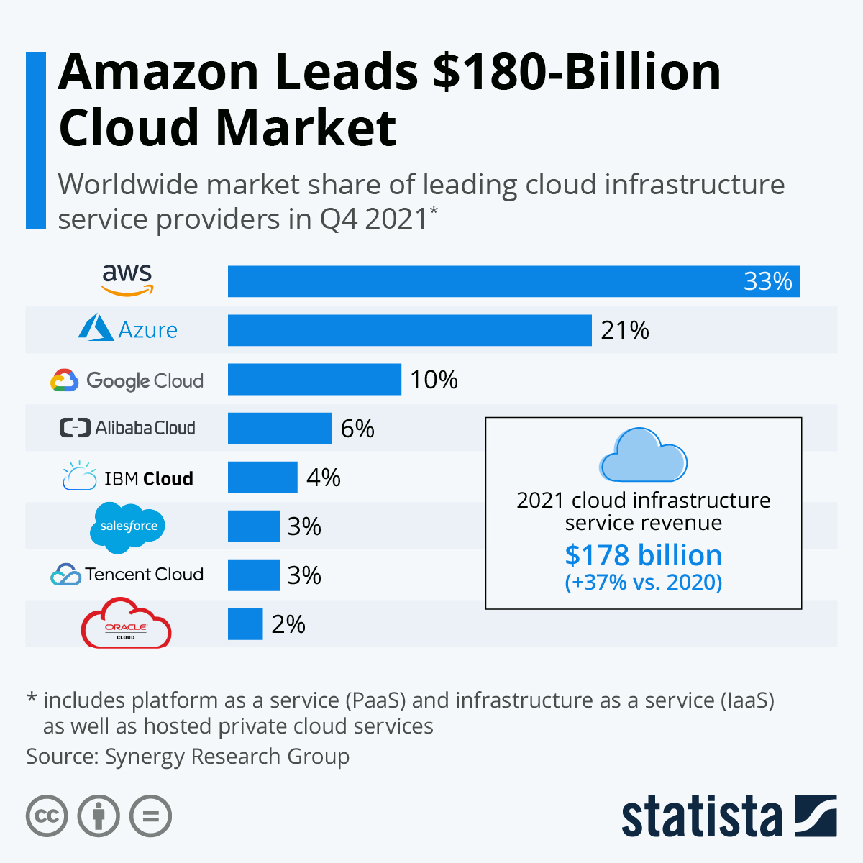
AWS Recognized as a Cloud Leader from 2006

Slide 11
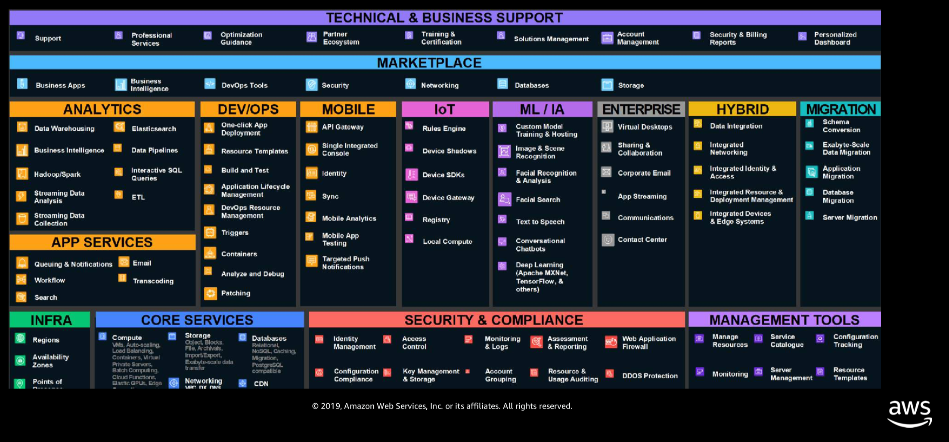

Slide 12
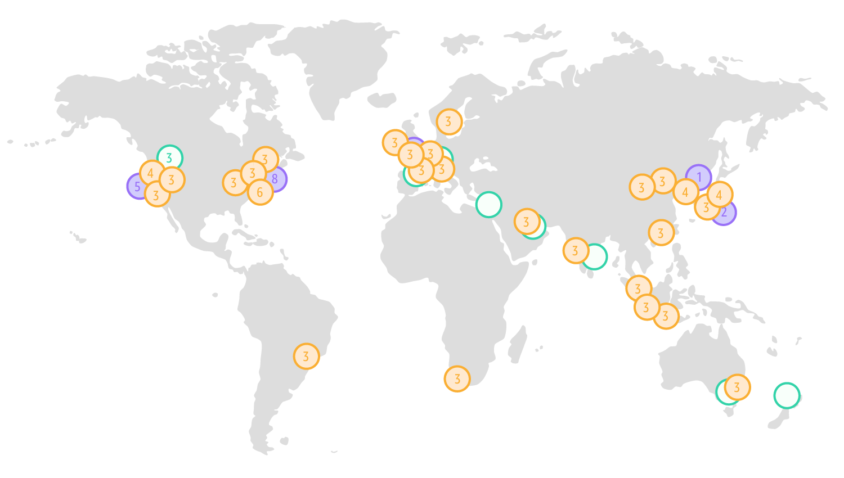
25 Regions
81 Availability Zone

Slide 13
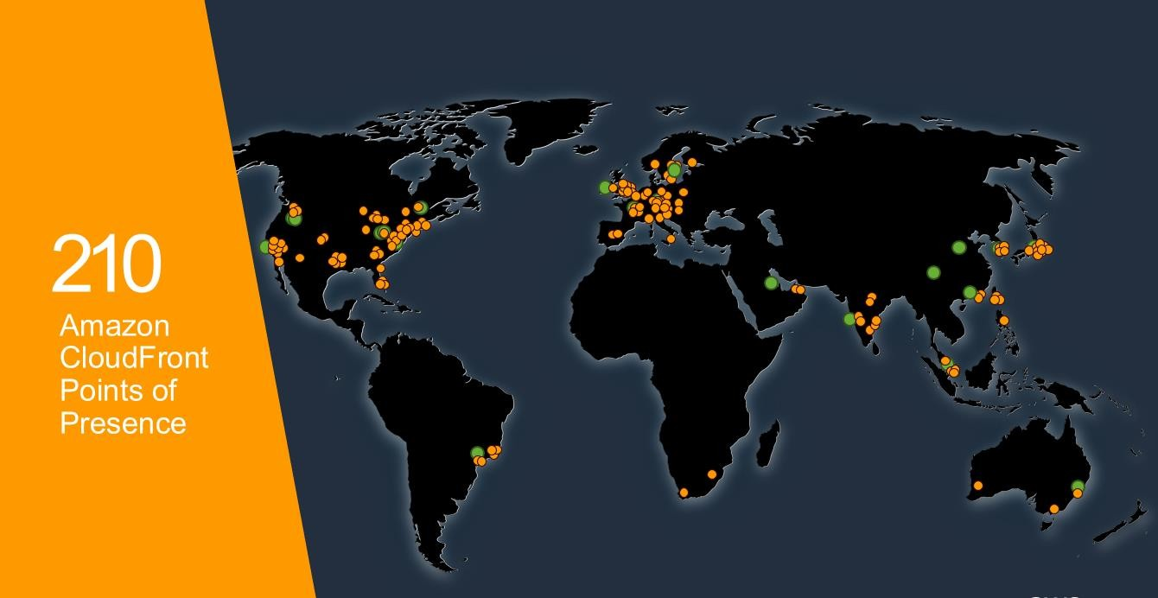

Slide 14
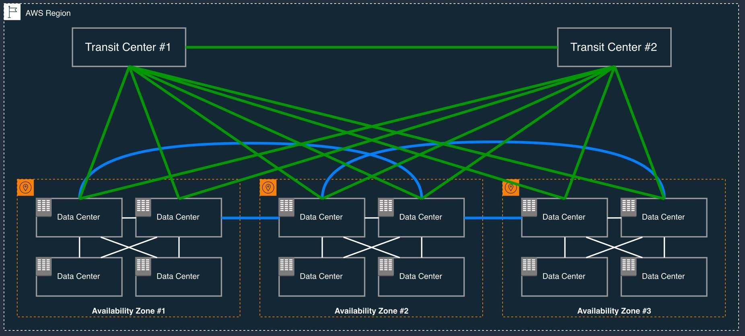
Availability Zones

Slide 15
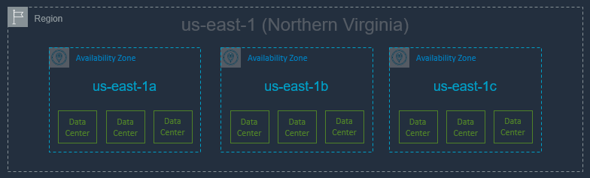
Availability Zones
A region is comprised of multiple Availability Zones (typically 3)
Fully independent partitions on isolated fault lines, flood plains, and power grids
Each AZ: redundant power and redundant dedicated network
Each AZ: typically multiple data centers
Between AZs: high throughput, low latency (<10ms) network
Between AZs: physical separation < 100km (60mi)

Slide 16
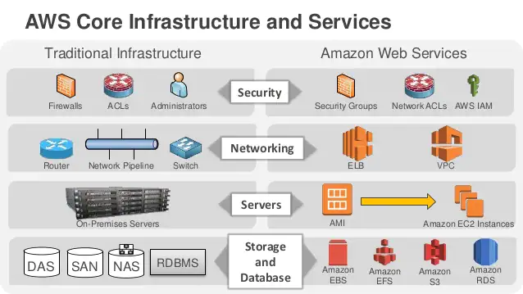
AWS Core Infrastructure and Services

Slide 17
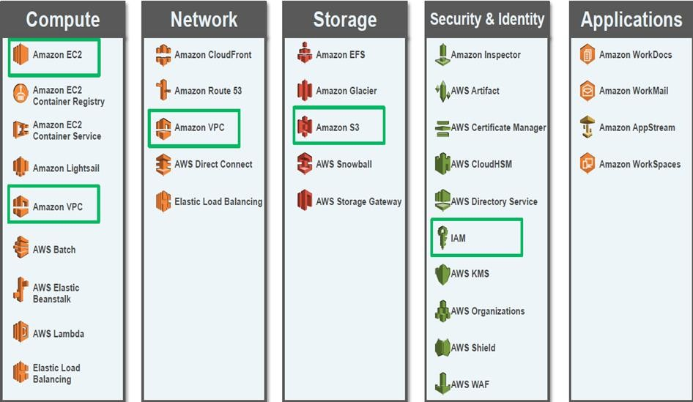
AWS Foundation Services
Notes:
Là những dịch vụ nền tảng của AWS

Slide 18
AWS Compute Overview

Slide 19
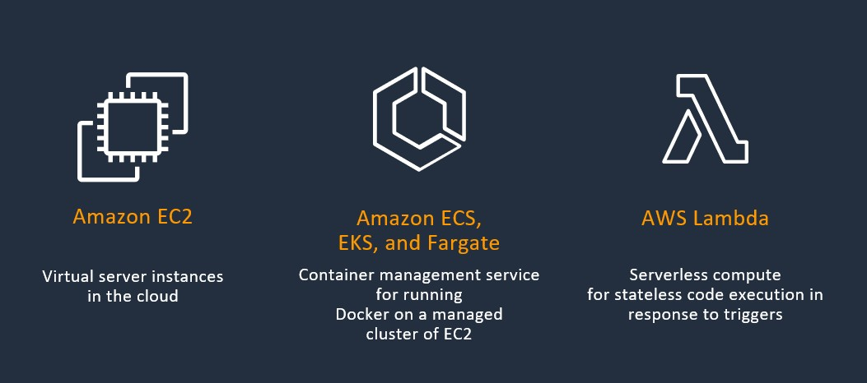
Compute types

Slide 20
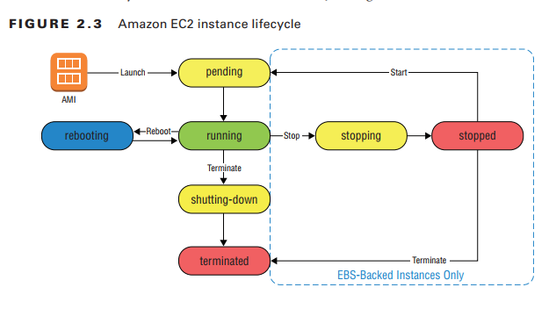
Amazon EC2
Amazon Elastic Compute Cloud (EC2): Enables you to provision computing environments called instances. With Amazon EC2, you have the ﬂexibility to choose the hardware resources you need.

Slide 21
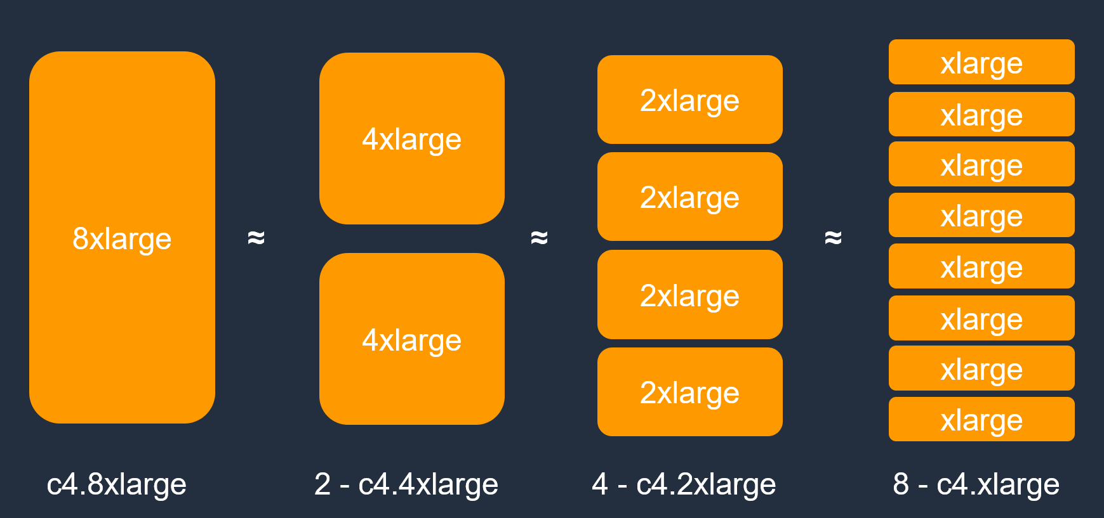
Instance Sizing
Notes:
8xlarge: 32 vCPU, 128gb Ram

Slide 22


EC2 Operating Systems Supported
Windows 2003R2/2008/2008R2/2012/2012R2/2016/2019
Amazon Linux
Debian
Suse
CentOS
Red Hat Enterprise Linux
Ubuntu
for more OSes see: https://aws.amazon.com/marketplace/b/2649367011

Slide 23
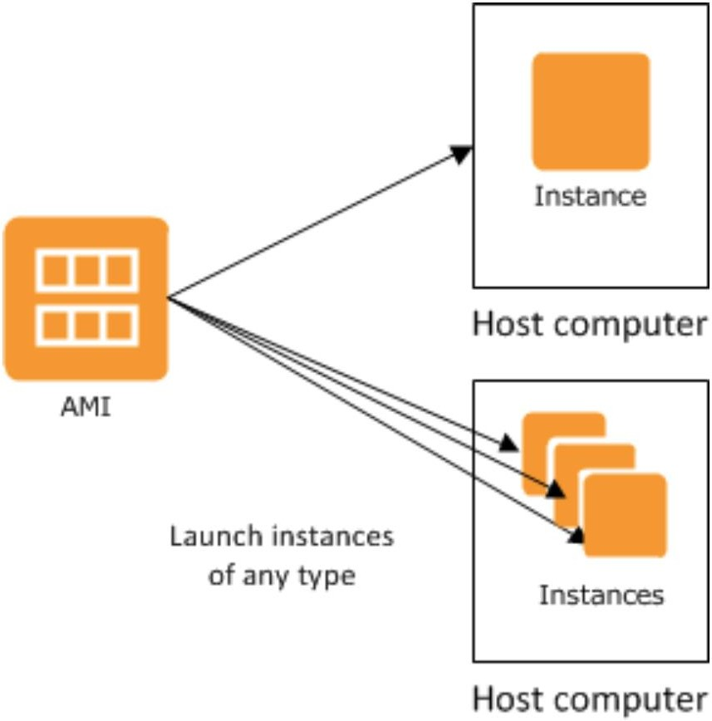
EC2 AMI
AMI
Instances are based on an Amazon Machine Image
While launching an instance, you may have a specific requirement such as an operating, system, preinstalled software, number of EBS volumes, and their respective size. To cater to such a requirement, AWS uses a feature called AMI.
AMIs are unique to each region

Slide 24
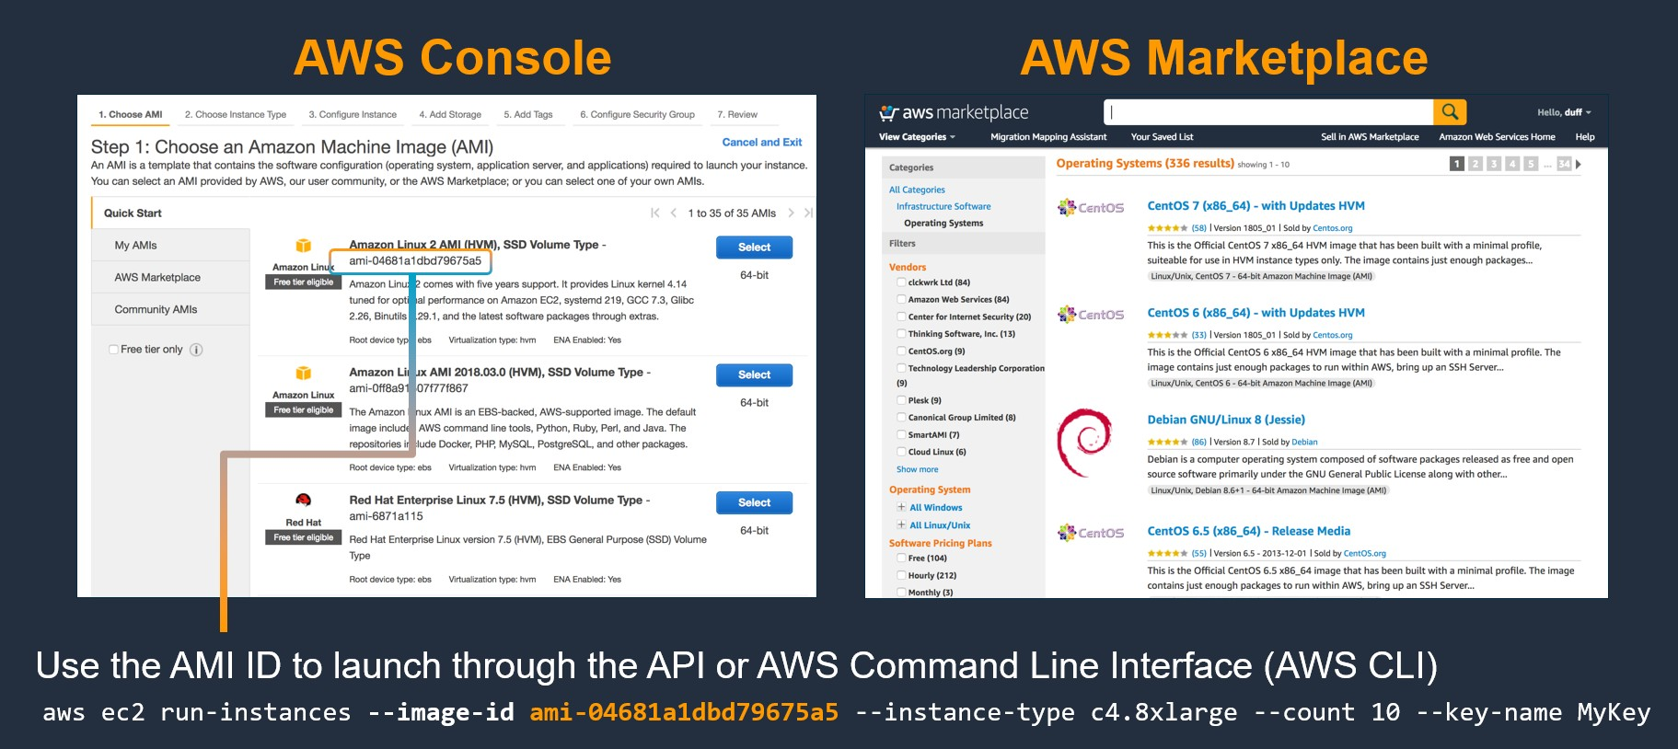
EC2 AMI

Slide 25
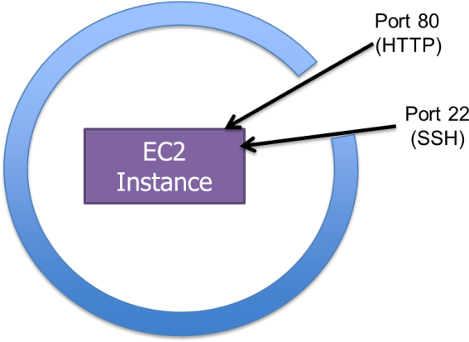
EC2 Security Groups
Security Group Rules
Name
Description
Protocol
Port range
IP address, IP range, Security Group name

Slide 26
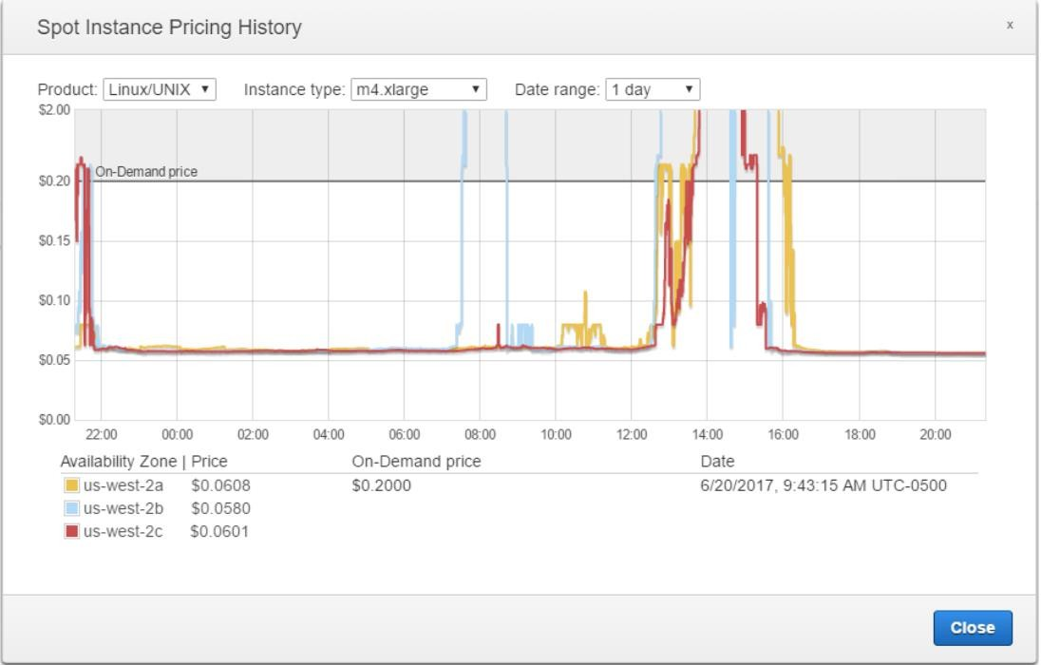
EC2 Pricing
On Demand Instance
This is the most common and flexible pricing option
Pay only for what you use
Stopped instances will not accrue hourly compute costs
Pay by the instance hour
Reserved Instance (RI)
1 or 3 year commitment
Spot
Useful for “worker pool” scenarios
Transcode, map reduce task nodes

Slide 27
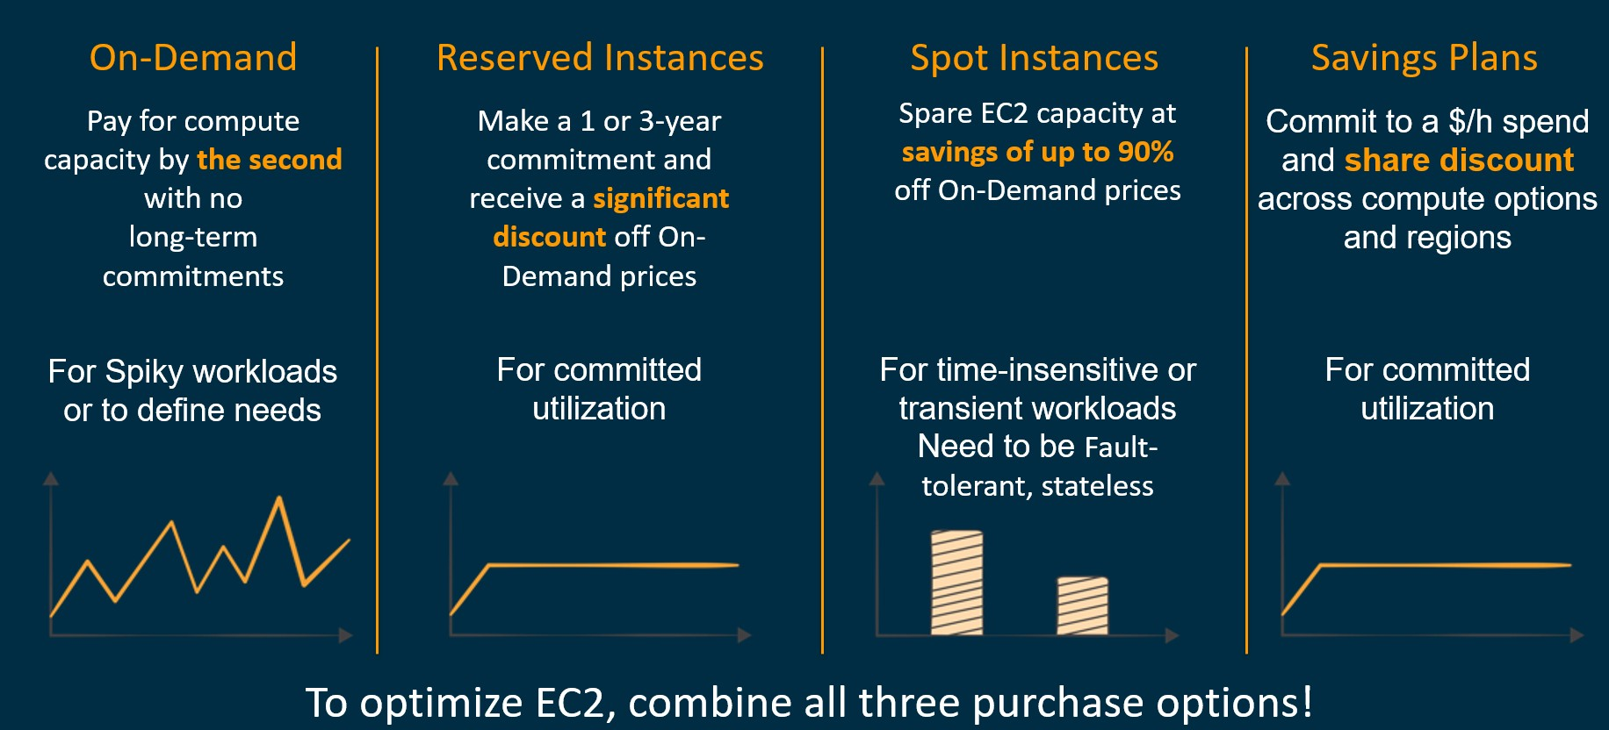
EC2 Purchasing Options

Slide 28
AWS Networking Overview

Slide 29
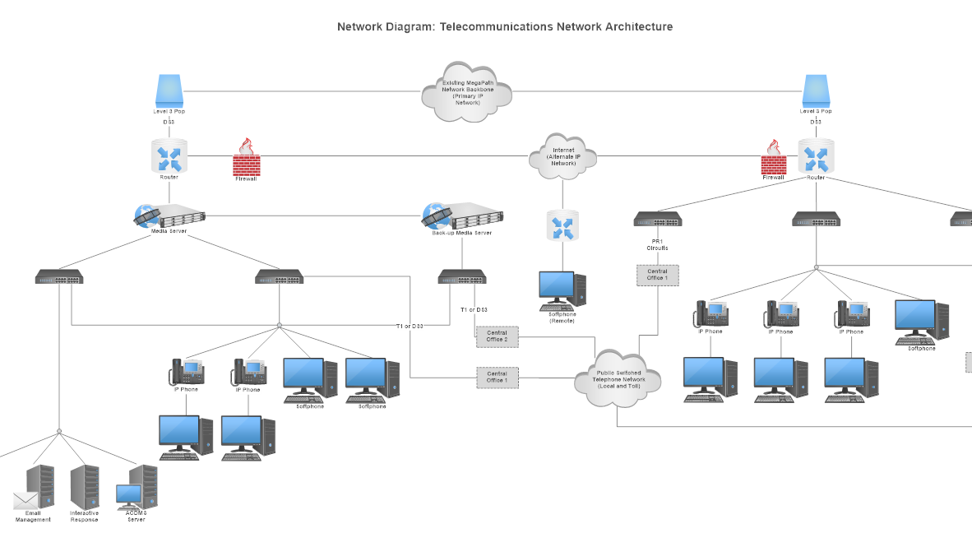

Slide 30
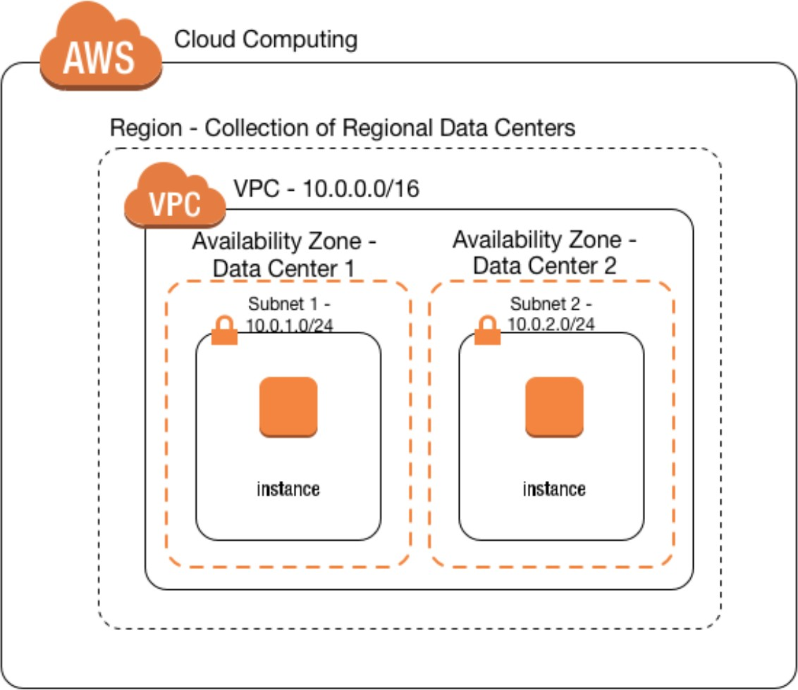
AWS Networking Components
“Your Virtual Datacenter in the Cloud”
Essential Components:
Subnets
Route Tables
Network ACLs
Security Groups
Internet Gateways
NAT Gateways

Slide 31
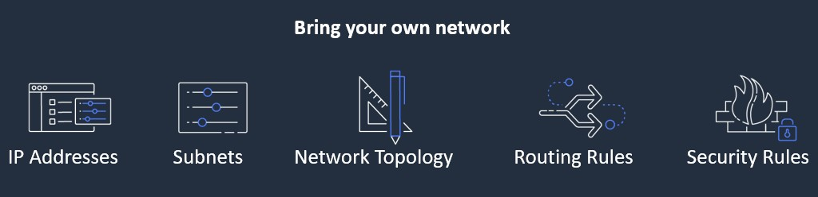
Amazon VPC – Virtual Private Cloud
Provision a logically isolated section of the AWS Cloud where you can launch AWS resources in a virtual network that you define.

Slide 32
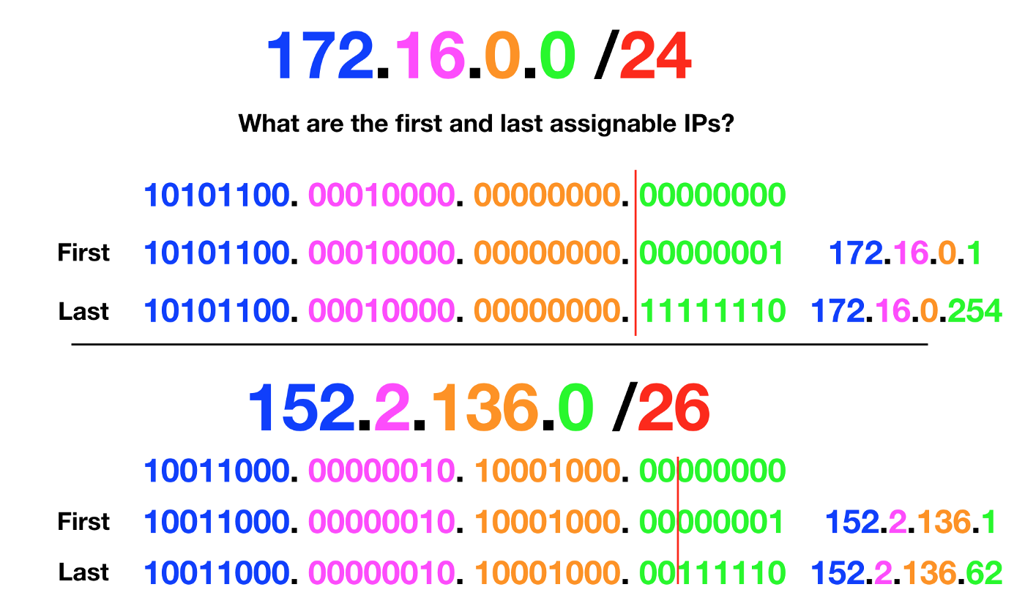
Classless Inter-Domain Routing (CIDR)
CIDR is a standard set of IPs used to
identify and distribute resources
(ex: EC2) in the network

Slide 33
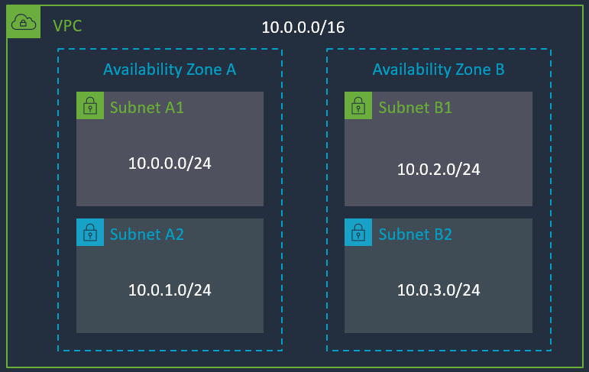
Subnet
You can add one or more subnets in each Availability Zone
Subnets are allocated as a subset of the VPC CIDR range

Slide 34
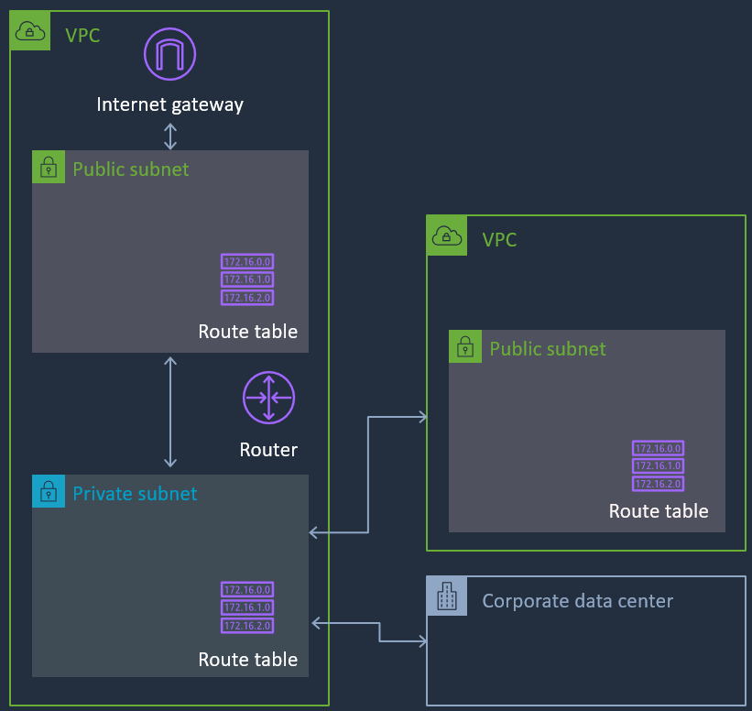
Subnet and Route Table
Each subnet can have a unique Route Table
Route Tables direct traffic out of the VPC, towards:
Internet Gateway
Virtual Private Gateway
VPC Endpoints
Direct Connect
VPC Peering
Subnets are named “Public Subnets” when connected to an Internet Gateway

Slide 35
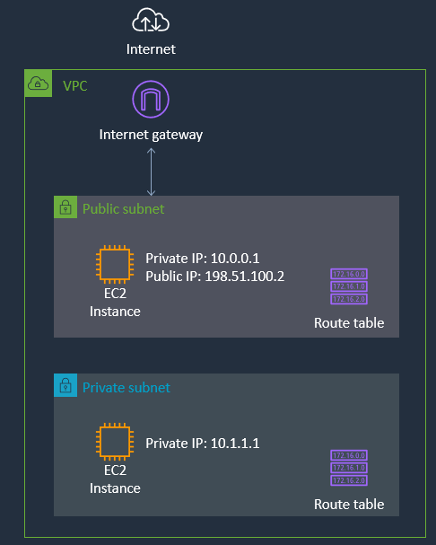
Internet Gateway
Connect your VPC Subnets to the Internet
Must be referenced on the Route Table

Slide 36
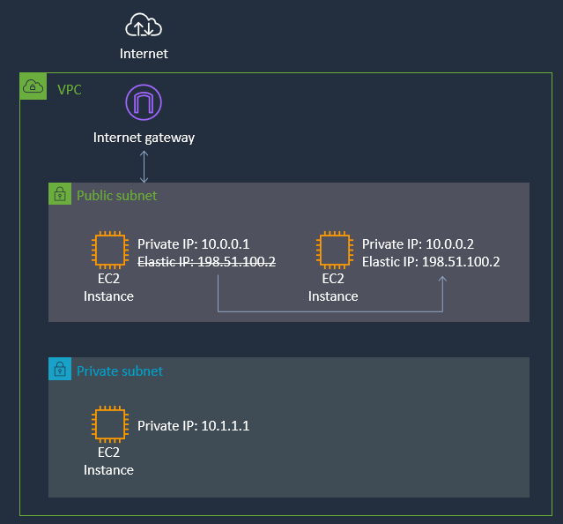
Elastic IP Address
Static, Public IPv4 address, associated with your AWS account
Can be associated with an instance or network interface
Can be remapped to another instance in your account

Slide 37
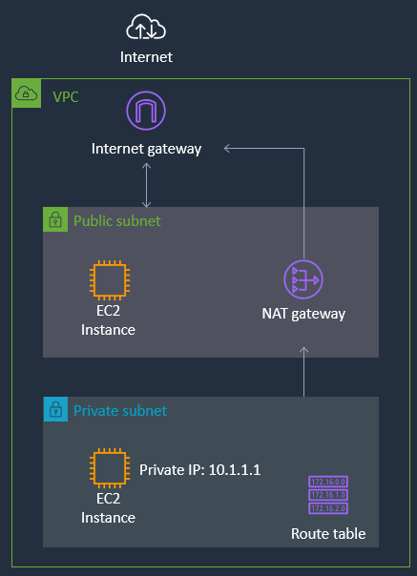
NAT Gateway
Enable outbound connection to the internet
No incoming connection - useful for OS/packages updates, public web services access
Fully managed by AWS
Highly available
Up to 10Gbps bandwidth
Supports TCP, UDP, and ICMP protocols
Network ACLs apply to NAT gateway’s traffic

Slide 38
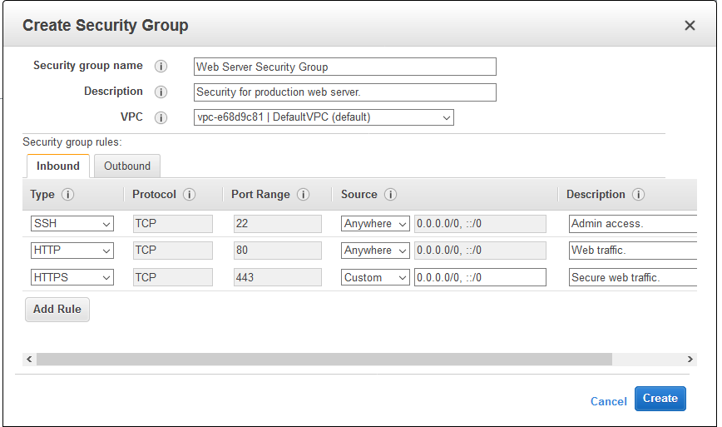
VPC Security - Security Groups
Virtual stateful firewall
Inbound and Outbound customer defined
rules
Instance/Interface level inspection
Only supports allow rules
Implicit deny all at the end

Slide 39
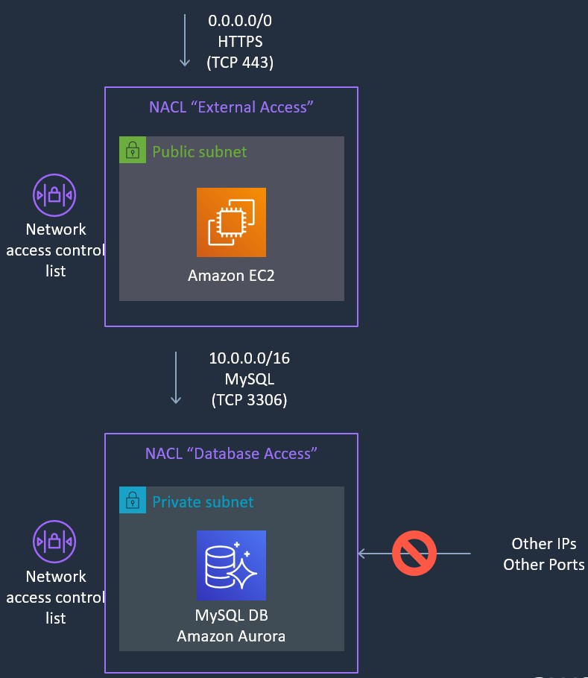
VPC Security - Network Access Control List
Inbound and Outbound
Subnet level inspection
Optional level of security
By default, allow all traffic
Stateless
IP and TCP/UDP port based
Supports allow and deny rules
Deny all at the end

Slide 40
AWS Storage Overview

Slide 41
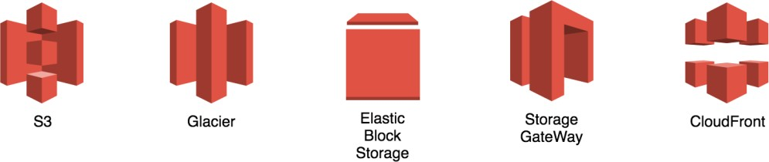
AWS Storage Services & Content Delivery

Slide 42
Amazon Simple Storage Service (S3)
Storage for the Internet
Natively online, HTTP access
Store and retrieve any amount of data, any time, from anywhere on the web
High Scalable, reliable, fast and durable

Slide 43
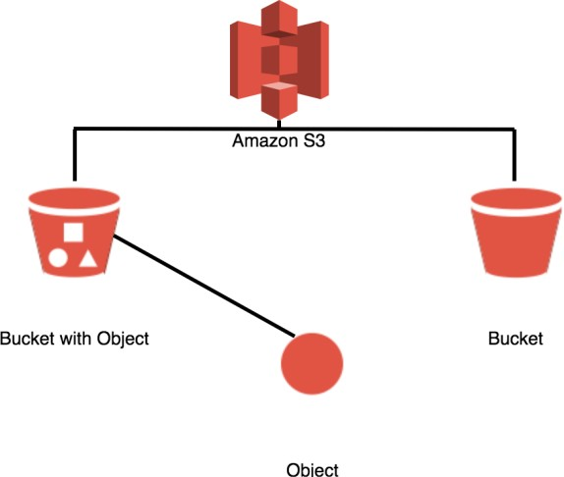
Amazon S3 Concept
Amazon S3 stores data as objects within buckets
Bucket name is unique in the world
An object is comprised of a file and optionally any metadata that describes that file
You can have up to 100 buckets in each account
You can control access to the bucket and its objects

Slide 44
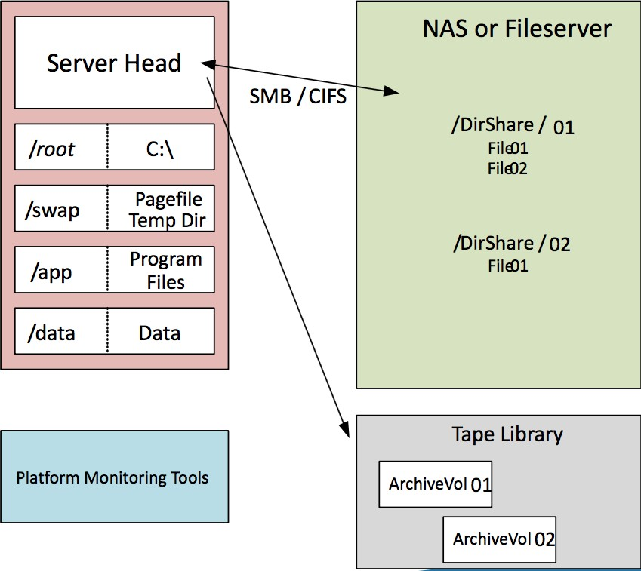
Traditional Platform - Storage Architecture
In the old days...
Hardware acquisition and datacenter space required advanced planning
Disk space and I/O allocation juggling for the entire application lifecycle
Volume and file redundancy not built-in
Capital commitment and refresh budget considerations

Slide 45
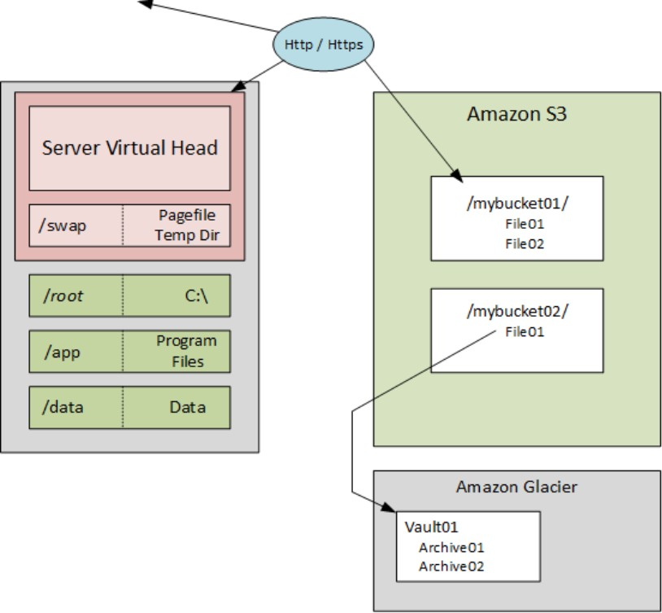
AWS Instance Volumes and Data Storage
The new [improved] way of doing things...
Elastic pay-as-you-go model
Redundancy and snapshot utilities built-in
New APIs and tools simplify application development, administration and data lifecycle management

Slide 46
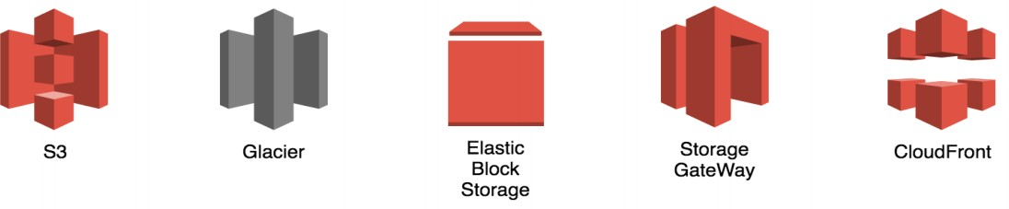
Amazon Glacier
Extremely low-cost storage
Secure, durable storage for data archiving and backup
Optimized for data that is infrequently accessed

Slide 47
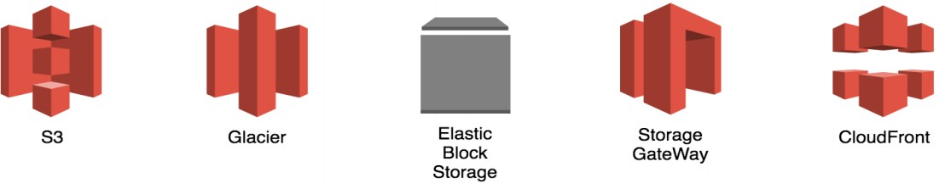
Amazon Elastic Block Store (EBS)
Persistent block level storage volumes offering consistent and low-latency performance
Automatically replicated within its Availability Zone
Snapshots stored durably in Amazon S3

Slide 48
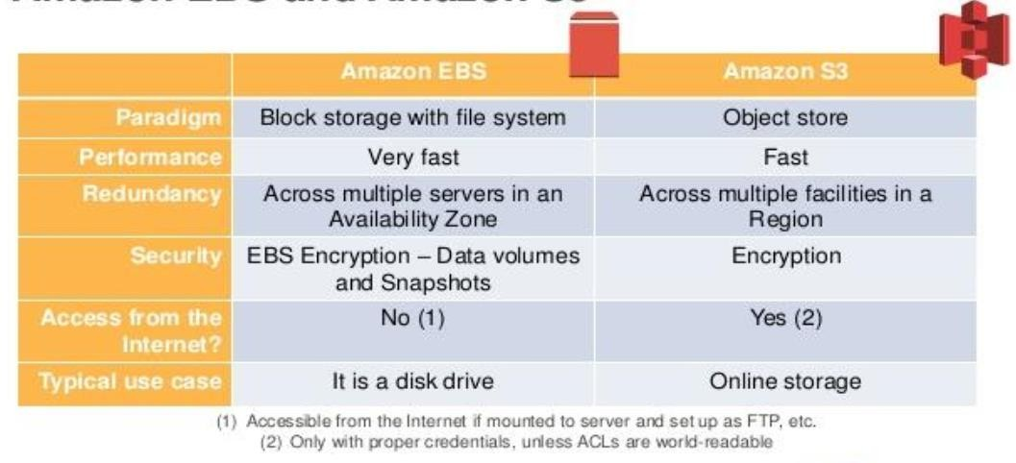
Amazon EBS vs Amazon S3

Slide 49
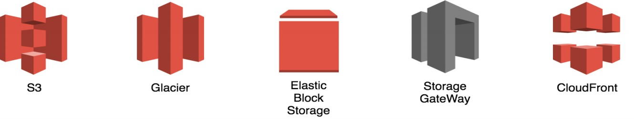
Amazon Storage Gateway
Connect an On-premises software appliance with cloud-based storage
Securely upload data to the AWS cloud for cost effective backup and rapid disaster recovery
Mirror your on-premises data to Amazon EC2 instances

Slide 50
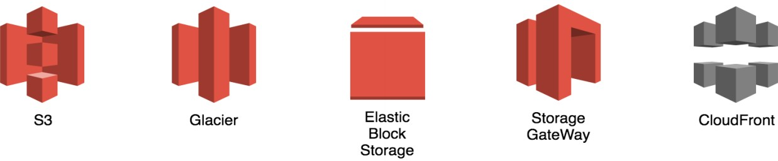
Amazon Cloud Front
Easy and cost effective way to distribute content to end users
Low latency, high data transfer speeds
Deliver your entire website, including dynamic, static, streaming, and interactive content using a global network of edge locations

Slide 51
AWS Database Overview

Slide 52
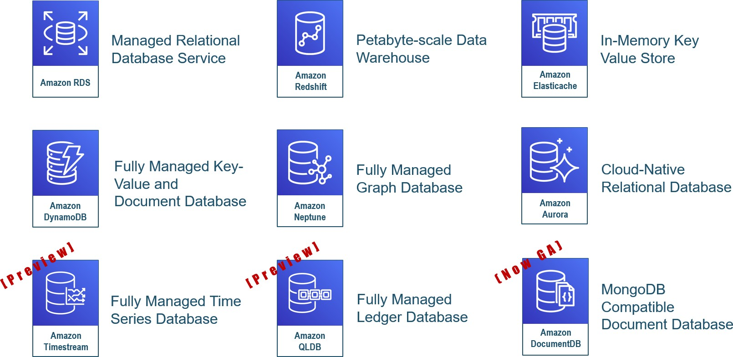
AWS Database Services

Slide 53


Traditional Database Architecture
Client Tier
one database for all workloads
App/Web Tier
RDBMS

Slide 54


AWS Data Tier Architecture
Client Tier
On AWS choose best database service for each workload
App/Web Tier
Data Tier
Cache | Data Warehouse | Time Series | Blob Store
NoSQL | RDBMS | Quantum Ledger | Search

Slide 55

AWS Database Services for the Data Tier
hot reads
analytics
logging
NoSQL
simple query
Graph / Key Value / Document
complex queries & transactions
rich search
Data Tier
Amazon ElastiCache
Amazon Timestream
Amazon Redshift
Amazon S3
Amazon QLDB
Amazon ElasticSearch
Amazon DynamoDB
Neptune / DocumentDB
Amazon RDS

Slide 56
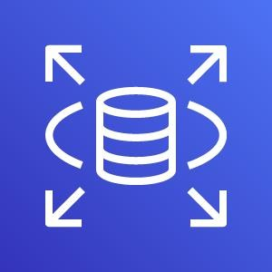
Easy to setup, operation and scale a relational database
Automatically patches the database software and backup your database
Amazon RDS
Ability to scale the compute resources or storage capacity associated with your relational database instance via a single API call

Slide 57





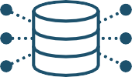

Amazon RDS
Managed relational database service with a choice of popular database engines
Easy to administer
Performant & scalable
Available & durable
Secure and compliant
Easily deploy and maintain hardware, OS and DB software; built-in monitoring
Scale compute
and storage with a few clicks; minimal downtime for your application
Automatic Multi-AZ data replication; automated backup, snapshots, and failover
Data encryption at rest and in transit; industry compliance and assurance programs

Slide 58


If you host your databases on-premises…
App optimization Scaling
High availability
Database backups DB s/w patches DB s/w installs
OS patches OS installation
Server maintenance
Rack & stack Power, HVAC, net
you

Slide 59

If you host your databases in Amazon EC2…
App optimization Scaling
High availability
Database backups DB s/w patches DB s/w installs
OS patches OS installation
Server maintenance
Rack & stack Power, HVAC, net
OS installation Server maintenance Rack & stack Power, HVAC, net
you

Slide 60
If you choose Amazon RDS…
App optimization Scaling
High availability
Database backups DB s/w patches DB s/w installs
OS patches OS installation
Server maintenance
Rack & stack Power, HVAC, net
you
Scaling
High availability Database backups DB s/w patches DB s/w installs
OS patches
OS installation
Server maintenance Rack & stack Power, HVAC, net

Slide 61





























Key Amazon RDS Features
Multi-AZ
Amazon RDS Configuration | Improve Availability | Increase Throughput | Reduce Latency
Push-Button Scaling
Multi AZ
Read Replicas
Provisioned IOPS
availability zone
availability zone
Region
Push-Button Scaling
Read Replicas
Provisioned IOPS

Slide 62
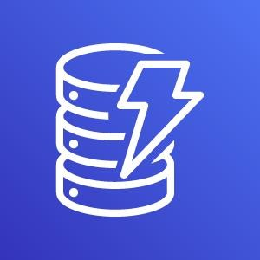
NoSQL database
Seamless scalability
Zero admin
Single-digit millisecond latency
Multi-Master
Multi-Region
Store any amount of data with no limits
Fast, predictable performance using SSDs
Easily provision and change the request capacity
needed for each table
Amazon DynamoDB

Slide 63

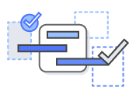
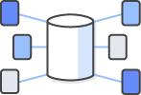

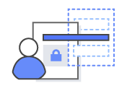
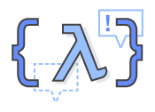

Amazon DynamoDB
Fully managed
Consistently fast at any scale
Highly available and durable
Integrates with AWS Lambda, Amazon Redshift, and more
Cost-effective
Secure

Slide 64
Highly available and durable
Designed to support 99.99%
of availability
Built for high durability
WRITES
READS
3-way replication Persisted to disk (Custom SSD)
Strongly or eventually consistent
No latency trade-off
Data is always replicated to three Availability Zones

Slide 65










Highly available and durable
3-way replication
OrderId: 1
CustomerId: 1
ASIN: [B00X4WHP5E]
Data is always replicated to
three Availability Zones
Hash(1) = 7B
Availability Zone A
Availability Zone B
Availability Zone C
Partition A
Partition B
Partition C
Partition A
Partition B
Partition C
PPaarrttititioionn AA
Partition B
Partition C
Host 1
Host 2
Host 3
Host 4
Host 5
Host 6
Host 7
Host 8
Host 9
CustomerOrdersTable

Slide 66
Backup and Restore
The only cloud database to provide on-demand and continuous backups
On-demand backups for long- term data archival and compliance
Point in time restore for short term retention and data corruption protection (35 days)
Point in time recovery with restore times in a few hours depending on table size

Slide 67

Questions?

